Slide 1
Broadcast Technology UG1
9: DVB, Compression Intro, TS, PS
Jerry Foss
jeremy.foss@bcu.ac.uk
DVB, COMPRESSION INTRO, TS, PS:
DVB
MPEG compression
PS,TS

Slide 2
Media Distribution Platforms
Media Distribution
The TV Headend
DVB - Digital Video Broadcasting
Transport Stream Multiplex
Distribution Network Archiectures
Satellite
Digital Terrestrial (DTTV)
Cable
HTTP Streaming: MPEG-DASH
Higher Definition
Content Delivery Networks

Slide 3
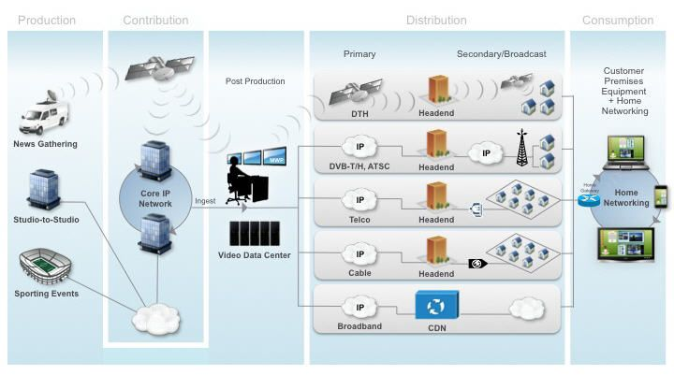
Contribution and Distribution
Production Contribution Distribution Consumption
http://www.cisco.com/c/en/us/solutions/service-provider/distribution/index.html#

Slide 4
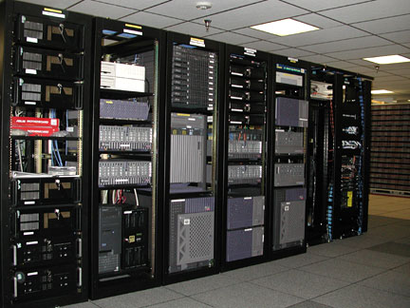
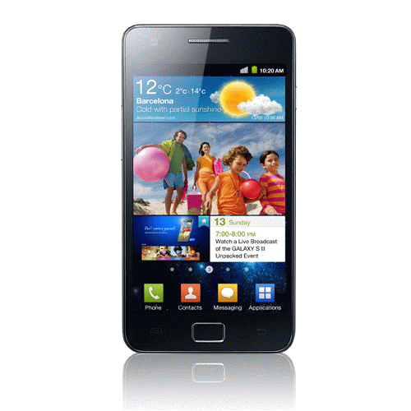
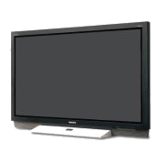

Media Distribution
Video Head-End
VOD and
Various
Functions
(Servers, etc)
Distribution Network
Satellite
Cable
Telco Broadband
Terrestrial TV
Web (OTT)
Mobile
End Users
Access to
WWW
Telephone N/W
Ingest of Media
STB, etc
Network Access Equipment

Slide 5
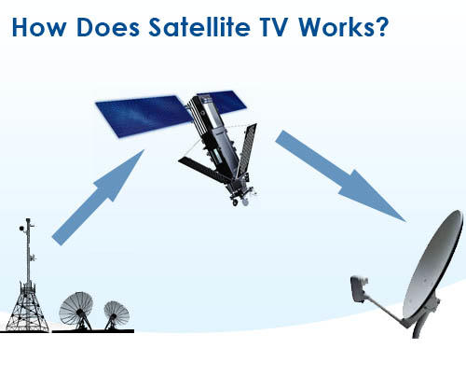
Media Distribution ... ... Satellite
Video Head-End
VOD and
Various
Functions
(Servers, etc)
End Users
Access to
WWW
Telephone N/W
Ingest of Media
STB, etc
Network Access Equipment

Slide 6

Media Distribution - Digital Terrestrial (DTTV)
Video Head-End
VOD and
Various
Functions
(Servers, etc)
End Users
Access to
WWW
Telephone N/W
Ingest of Media
STB, etc

Slide 7
Media Distribution – Cable
Video Head-End
VOD and
Various
Functions
(Servers, etc)
Cable Network
Network Managed and Operated by Network Provider / Operator
- Routing, Switching, etc
End Users
Access Network
Access to
WWW
Telephone N/W
Ingest of Media
STB, etc
Network Access Equipment

Slide 8
Media Distribution – IPTV - Telco Broadband, OTT/Web
Video Head-End
Telco Broadband
VOD and
Various
Functions
(Servers, etc)
Network Core
Network Managed and Operated by Network Provider / Operator
- Routing, Switching, etc
End Users
Access Network
Access to
WWW
Telephone N/W
Ingest of Media
STB, etc
Network Access Equipment

Slide 9
Media Distribution – IPTV - Telco Broadband, OTT/Web
Video Head-End
Telco Broadband
VOD and
Various
Functions
(Servers, etc)
OTT
Network Core
Network Managed and Operated by Network Provider / Operator
- Routing, Switching, etc
End Users
Access Network
Access to
WWW
Telephone N/W
Ingest of Media
OTT
STB, etc
WEB-BASED VIDEO PROVIDER
Network Access Equipment

Slide 10
Media Distribution
Broadcast
but what is “broadcast?”
… vs On Demand
(what are “video servers”? – or any other server)
digital cinema distribution
Streaming:
DVB – Cable, Satellite, DTTV
IP-based – IPTV (Telco broadband, OTT)
http
MPEG → DASH (dynamic adaptive streaming on http)
HLS (http live streaming, Apple implemented)
rtp protocol

Slide 11
The Headend (Cable, Satellite, Web, Telco ... )
Video Head-End
Off air
Content
Encoding /
Transcoding
Multiplexing
Prepare for
Transmission
modulation, etc
VOD and
Various
Functions
(Servers, etc)
Local
Content
Transmission
Network
cable
satellite
Telco IPTV
Web
Conditional
Access
End Users
EPG
Middleware
Advertisment Inserts
Customer
Home
Modem
Set Top Box
inc CA
TV
Authentication
STB, etc
DHCP
Network Access Equipment
Additional Services

Slide 12
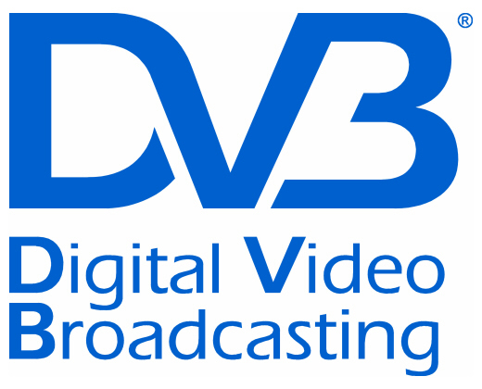
DVB - Digital Video Broadcasting
Standards
Satellite DVB-S, DVB-S2, SH
Cable DVB-C, DVB-C2
DTT DVB-T, DVB-T2
DTT for handhelds DVB-H, DVB-H2
DVB-3DTV - Frame Compatible Plano-Stereoscopic 3DTV
DVB-C2 - 2nd Generation Cable Transmission
DVB-CID - Carrier Identification for Satellite Transmission
DVB-CPCM - Content Protection and Copy Management
DVB-FF - DVB File Format
DVB-GEM - Globally Executable MHP
DVB-GSE - Generic Stream Encapsulation
DVB-H - Broadcasting to Handheld Devices
DVB-IPDC - Internet Protocol Datacasting
DVB-IPTV - Internet Protocol Television
DVB-MHP - Open Middleware for Interactive TV
DVB-PCF - Portable Content Format
DVB-RCS2 - Return Channel Satellite
DVB-RCT - Return Channel Terrestrial (03/2001)
DVB-S2 - 2nd Generation Satellite Broadcasting
DVB-SH - Satellite Services to Handheld Devices
DVB-T - Digital Terrestrial Television
DVB-T2 - 2nd Generation Terrestrial Broadcasting
DVB - Emergency Warning System
DVB Project - An Introduction
Hierarchical Modulation in DVB-T (03/2000)
plus many others (inc addenda, etc) …
Industry Organisation
Standardisation Process –
Joint Technical Committee (JTC) of:
ETSI - European Telecommunications Standards Institute
CENELEC - European Committee for Electrotechnical Standardization CENELEC
EBU - European Broadcasting Union
Note standards refer to other standards and patents, e.g. MPEG
http://www.dvb.org/standards/factsheets

Slide 13
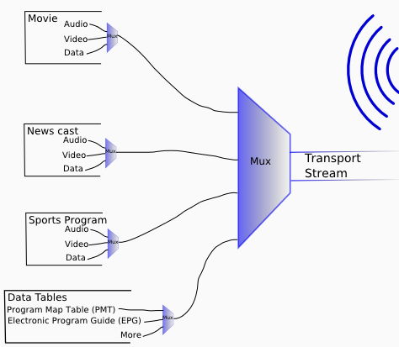
Transport Stream Multiplex
Transmission:
Terrestrial
Cable
Satellite
Broadband
Program Streams

Slide 14
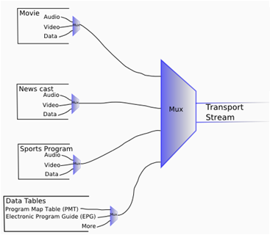

Transport Stream Multiplex
Multiplexer
Multiplex
Several TV channels as video packet streams … H.264/AVC or H.265/HEVC
Ch1
Ch2
Ch3
A
A
A
D
D
D
V
V
V
Multiplex
V
Ch1
V
Ch3
V
Ch4
A
Ch1
V
Ch3
D
Ch2
SI
Ch1
V
Ch1
V
Ch4
SI
SI
SI
etc
etc
etc
10010010001001010101110010011001010100010100000.....
SI = Service Information

Slide 15
Distribution Network Architectures

Slide 16
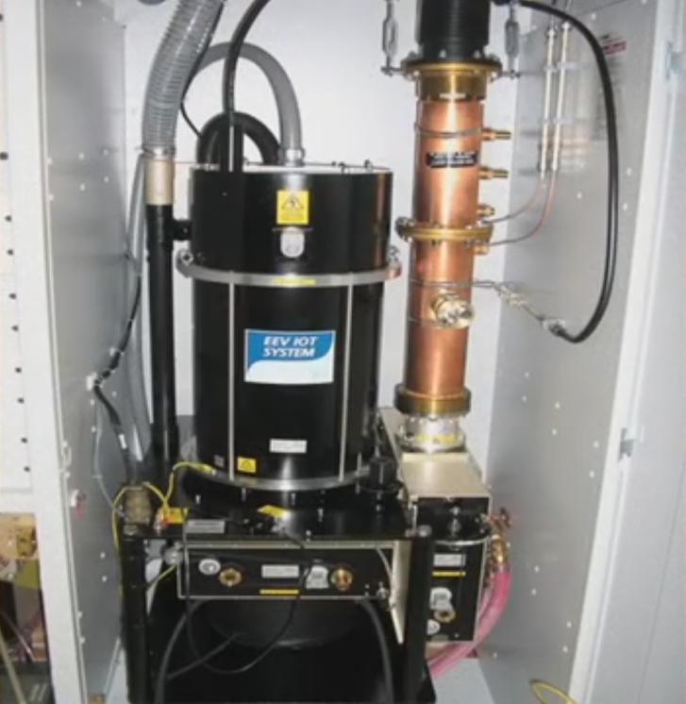
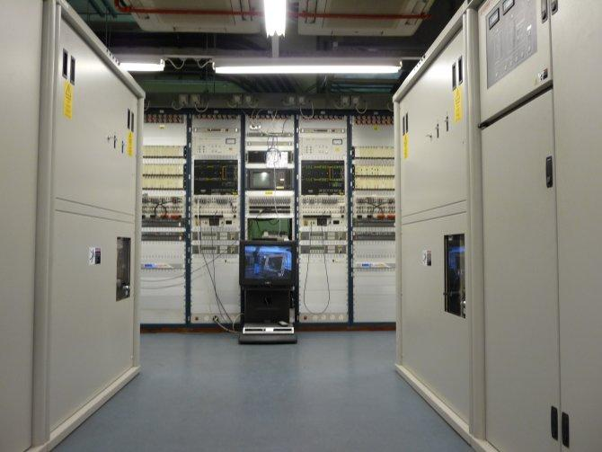
Digital Terrestrial
TV
(DTTV,
e.g.
Freeview)

Slide 17
Digital Terrestrial TV (DTTV, e.g. Freeview)
7Mhz Channel
contains a number of DVB-T TV channels
Ch21
48 channels
Ch68
475MHz
850MHz
UHF Band IV, V

Slide 18
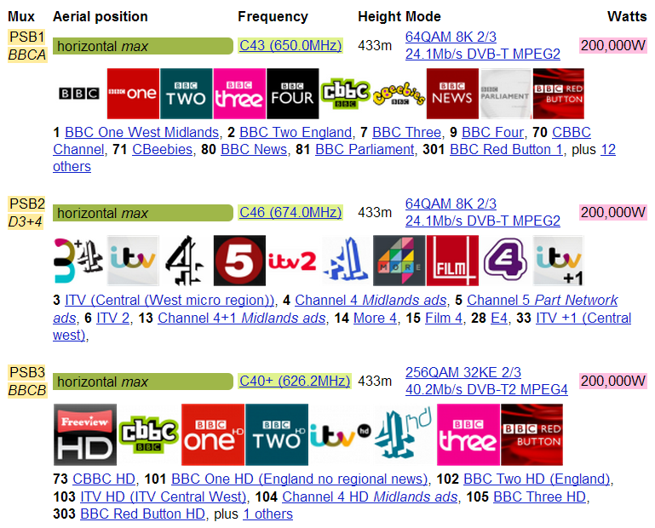
Freeview – Sutton Coldfield Transmissions (9 Multiplexes altogether)
http://www.ukfree.tv/txdetail.php?a=SK113003

Slide 19
Digital Terrestrial TV (DTTV, e.g. Freeview)
7Mhz Channel
contains a number of DVB-T TV channels
– a transport stream modulated on many carriers
Ch21
48 channels
Ch68
475MHz
850MHz
UHF Band IV, V

Slide 20
Multiplexing the Channels
V
Ch1
V
Ch3
V
Ch4
A
Ch1
V
Ch3
D
Ch2
SI
Ch1
V
Ch1
V
Ch4
Total data to be transmitted
00100010010101011110010010001001010101110010011001010100010100000.........
Data is modulated on to each of several carriers
freq
Each of these is one carrier with data modulated on to it in Quadrature Amplitude Modulation
(QAM – a mix of amplitude and phase modulation)
All these carriers are separate signals and are all modulated on to one main carrier

Slide 21
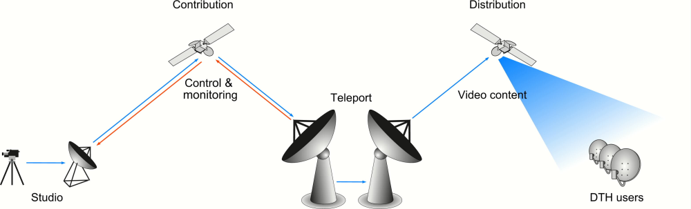
Satellite Distribution
Video Headend
image from
http://upload.wikimedia.org/wikipedia/en/8/80/Sat_contribution_fig.jpg

Slide 22
Satellite TV
DBS - Direct Broadcast Satellite; Broadcasting Satellite Service
One-way broadcast
From a communications satellite to an end user
Uplink: large dish 9-12m dia
Receiver - Small round or oval dish antenna < 20" diameter.
Compressed digital signal in the K_{u} band
(11-15GHz)
Reception affected by
rain
solar activity
http://www.supersatelliteselection.com/how-satellite-tv-works.html

Slide 23
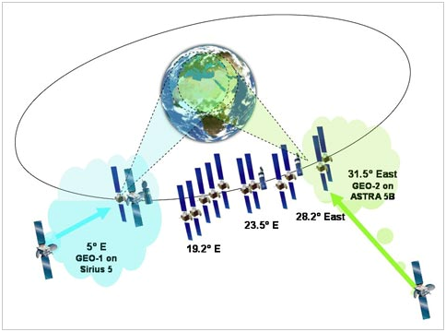
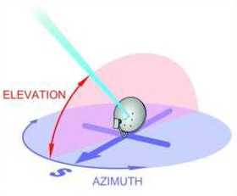
Geostationary Orbit
36,000 km
= 22,250 miles
Some satellite data …
SES Astra satellites located at 28.2° east (Astra 2A/2B/2C/2D)
Eutelsat's Eurobird 1 satellite at 28.5°E
appears as a fixed position to an earth-based observer
revolves around the earth at a constant speed once per day over the equator
ground based antennae - no need for expensive tracking equipment
receiver dish parameters

Slide 24
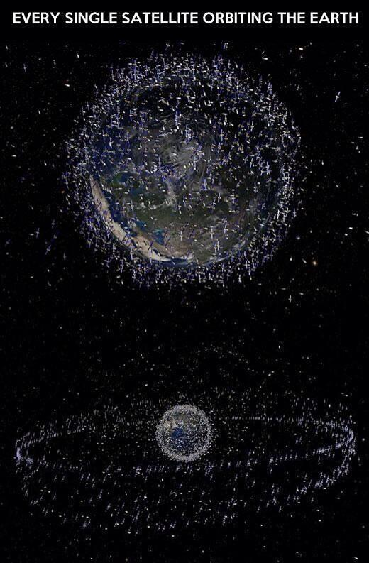
March 2014

Slide 25
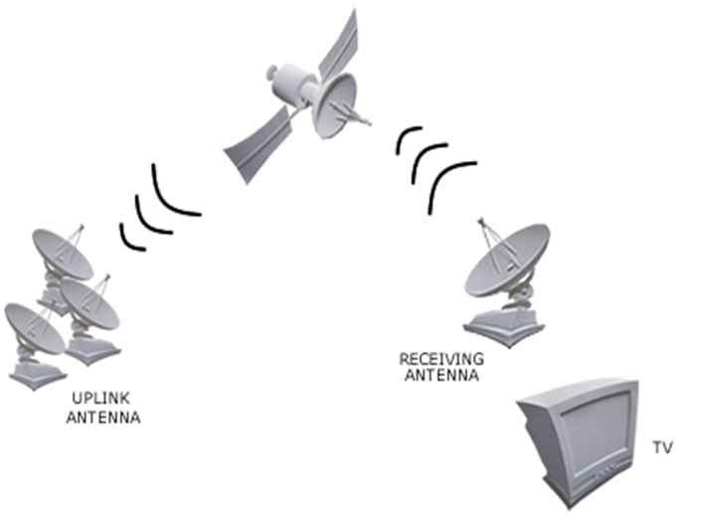

Satellite Transponders
Each Transponder is a separate transceiver or repeater
Each transmission channel is a multiplex of several digital TV channels
(note – bigger transmission channels than DTT
∴ many more TV channels in each multiplex)
24 x 36MHz transmission channels in 11GHz band
24 x 36MHz channels in 6GHz band
http://www.dream.com.ph/howdreamworks/hwd_schematic.asp

Slide 26
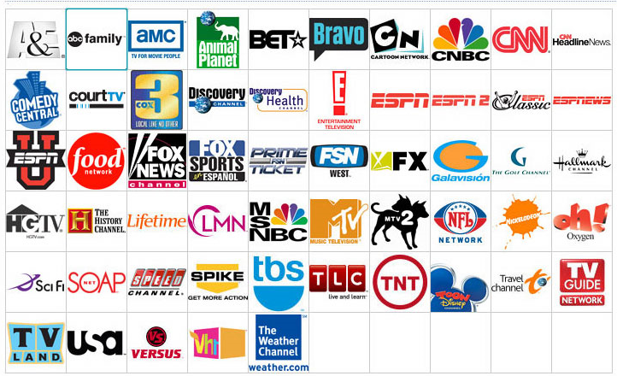
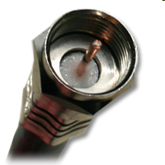
Cable TV

Slide 27
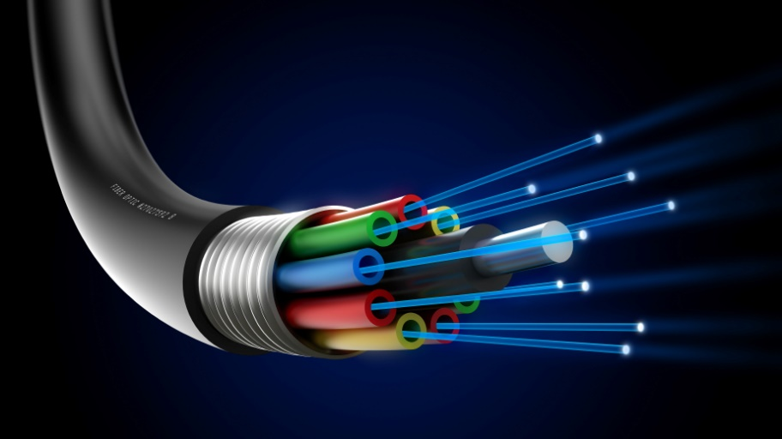
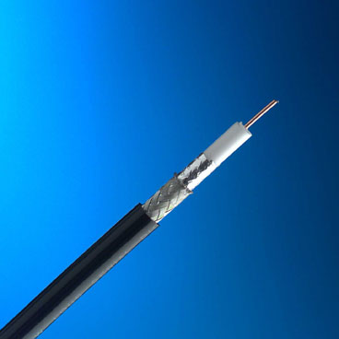


Cable TV
HFC network - hybrid fibre-coax network
Combine both optical-fibre and coaxial cable lines.
Optical fibre
- from the cable head-end to neighbourhoods of 500 to 2,000 subscribers.
Hybrid networks:
fibre's reliability and bandwidth benefits
lower cost than a pure fibre network
utilising existing copper plant
TAP
Fibre Trunk
Coax Trunk
Headend
Router
TAP
Branch
Drop
TAP
Coaxial cable
- from the optical-fibre feeders to each subscriber's home.
Notes:
-----------------------------------------
>> CMTS

Slide 28
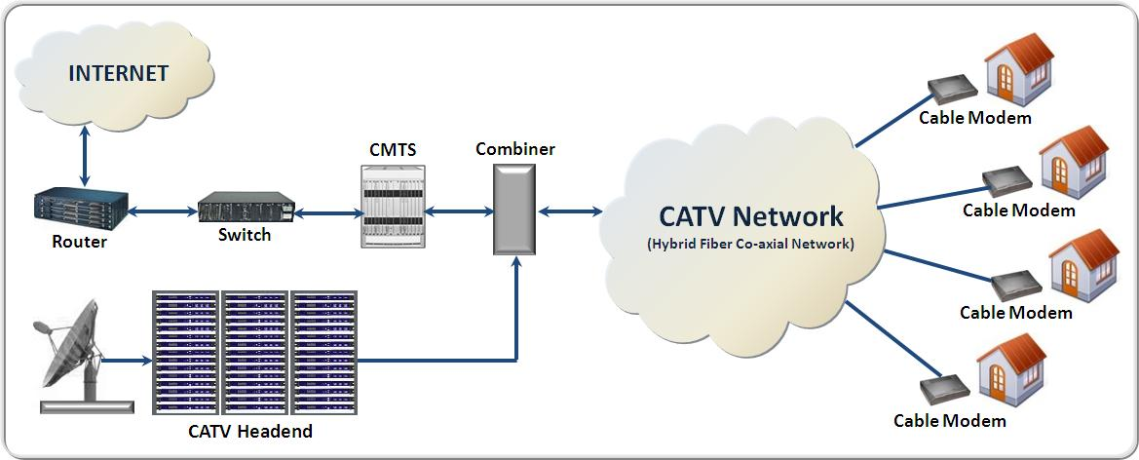
Cable TV – Data and TV to the user
Interface
DOCSIS
Data
DOCSIS - Data Over Cable Service Interface Specification
The Standard for the interface between the CMTS and the Cable Modem
Developed and licensed by CableLabs
Specifies modulation schemes and protocol
for exchanging signals over cable
to carry MPEG and IP

Slide 29
Cable TV – Data and TV to the user
UPSTREAM
to network
DOWNSTREAM
to user
signal
freq
sub-channels

Slide 30
Telecomms Service Providers (Telco)
Broadband Access

Slide 31
xDSL (ADSL, XDSL)
Telephony
UPSTREAM
DOWNSTREAM
signal
freq
sub-channels

Slide 32





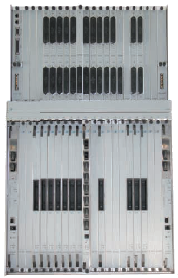
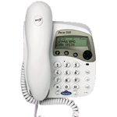
Telco Broadband (IPTV)
VOD Server
Middleware
Broadcast
Video Head-End
IP Router
DSLAM
Digital Subscriber’s Line Access Module
WWW
Network
Customer Premises
PSTN
Public Service Telephone Network
Notes:
IP services
>>>> - SSw
>>>> - www
>>>> - Walled Garden
>>>> - video headend
>>>> Network
- (MSAN)
IP Router
- ASX4000, BXR 48000
>>>> B-RAS
migrate to edge - to MSAN
[more later]
---------------------
Second Mile - Ethernet

Slide 33
VOD Server
Middleware
Broadcast
Video Head-End
Ethernet
Fibre
VDSL
IP Router
Street
Cabinet
DSLAM
Walled Garden
bRAS
WWW
Network
Customer Premises
PSTN access

Slide 34
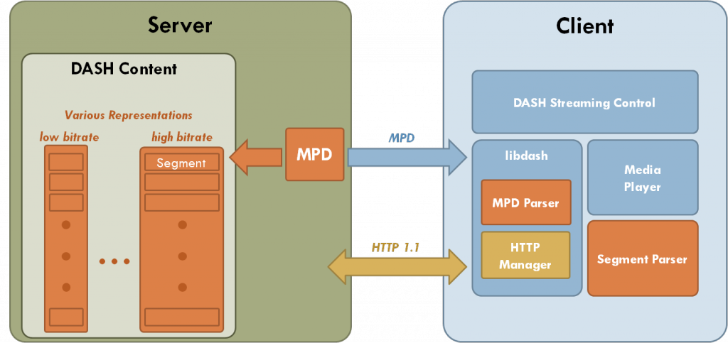
HTTP Streaming: MPEG-DASH
Streaming content
from HTTP server
to a DASH client
content stored on HTTP server; delivered using HTTP
Content exists on the server in two parts:
Media Presentation Description (MPD)
content presentation types, its various alternatives, their URL addresses, etc
Segments - contain the content bitstreams
in the form of chunks, in single or multiple files.

Slide 35
How Much Access Bandwidth? (up to recently ...)
Video (biggest payload)
assume MPEG4 / WM9, say
2x SD streams = 2 x [0.5 ... 1Mbs]
+ 2 x HDTV streams = 2 x [3 … 6Mbs]
= … … … … … … … ~ 10 … 15Mbs
Data
assume RT (or better) download video … ~ 2 … 3 Mbs
Voice
(negligible) ~ …
Total … … … … … … … … < 20Mbs
Contentious figures!
But quite likely
however - UHD, HDR, Frame Rates…
Notes:
How much access bandwidth?
- 100Mbs common in far east
- 1Gbs in HK
- (what do they do with it?)
... instantaneous transfer of entire contents of HD
... data back up
====================
Value Model - Players - Introduce some scenarios
-----------------------------------------
Media Industry Models

Slide 36
Content Delivery Networks

Slide 37
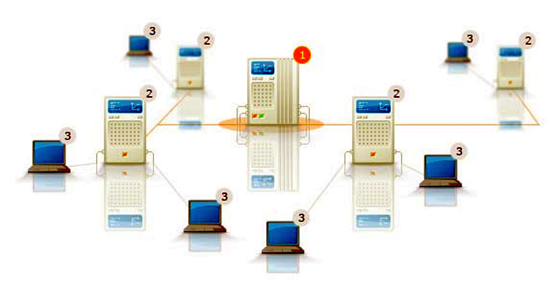
Content Networking
Internet - end-to-end
core network is simple - only forwards data packets
intelligence is at edges
1 – central server
2 – cache (edge server/cache)
3 – end users
CDN - to optimize content delivery
infrastructure solutions to network service providers who deploy their own dedicated digital media delivery
asset tracking
network performance
real-time load
statistics reporting

Slide 38
Content Networking
system of caches containing copies of data
data is distributed at various points in a network
maximizes the bandwidth required to access the data from clients throughout the network
1 – central server
2 – cache (edge server/cache)
3 – end users

Slide 39
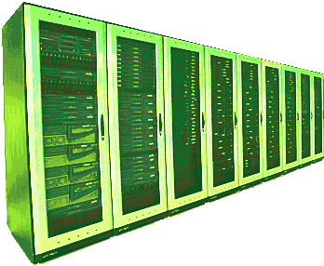
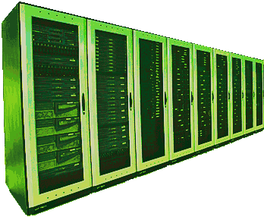
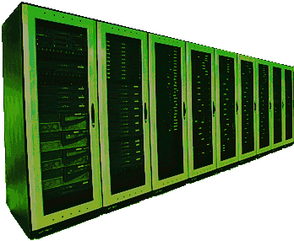
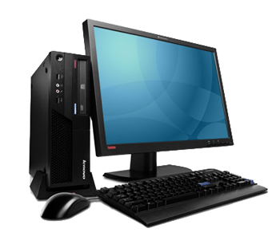

The Cloud
Not really a cloud (!)
a facility of servers and processors
may be private owned
may be third party owned
resources rented out
service level agreements
Storage
Processing
Software as a Service (SaaS)
Platform as a Service (PaaS)
e.g.
media workflow facilities
video headends
etc …

Slide 40
Cloud Computing, Amazon Instances
Instance | EC2 Compute Units | Memory (GB) | Instance Storage (GB) | Platform | I/O Performance | Hourly Price
Small | 1 (1 Virtual Core x 1 Compute Unit) | 1.7 | 160 | 32-bit | Moderate | $0.10
Large | 4 (2 Virtual Core x 2 Compute Unit) | 7.5 | 850 | 64-bit | High | $0.40
X-Large | 8 (4 Virtual Core x 2 Compute Unit) | 15 | 1690 | 64-bit | High | $0.80
High-CPU Medium | 5 (2 Virtual Core x 2.5 Compute Unit) | 1.7 | 350 | 32-bit | Moderate | $0.20
High-CPU XL | 20 (8 Virtual Core x 2.5 Compute Unit) | 7 | 1690 | 64-bit | High | $0.80
http://gevaperry.typepad.com/main/2009/03/figuring-out-the-roi-of-infrastructureasaservice.html
(more information at - http://aws.amazon.com/ec2/instance-types )

